Slide 1
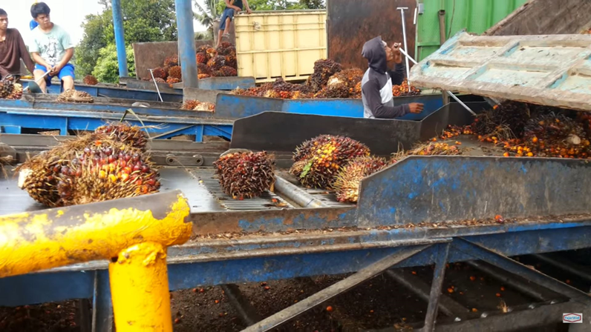
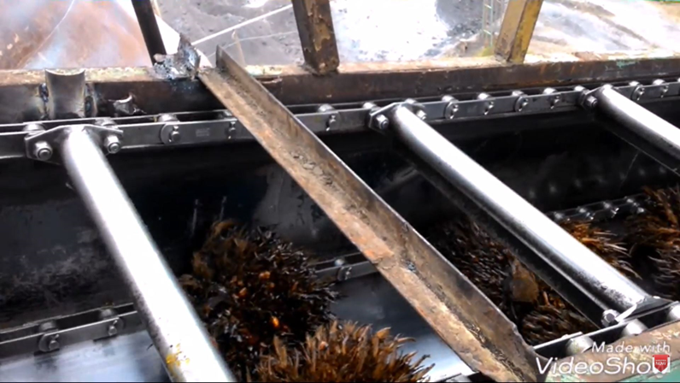
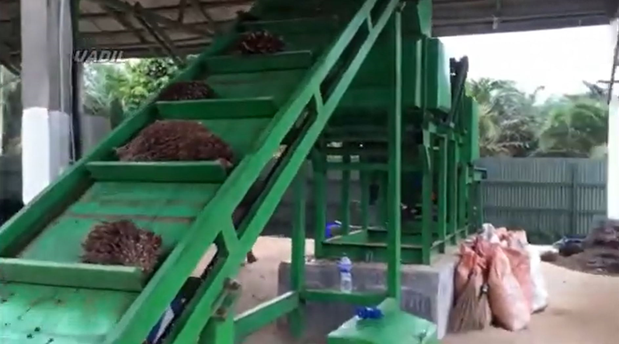
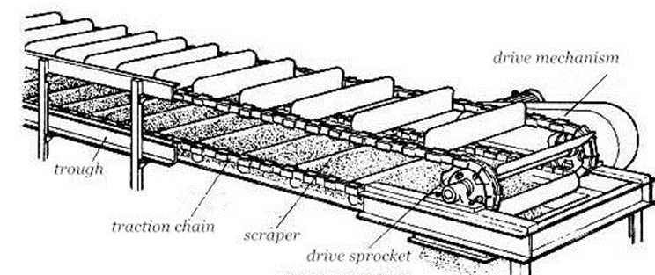
Scraper Chain Conveyor
Using Bottom Side
Using Top Side

Slide 2
Video Example
https://www.youtube.com/watch?v=gGks1ja22eU

Slide 3
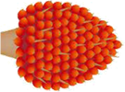
Sortation Idea
Sliding Door
Electrical Cylinder
Direction of belt
PLC
1m
80 cm
Direction of belt
PLC

Slide 4
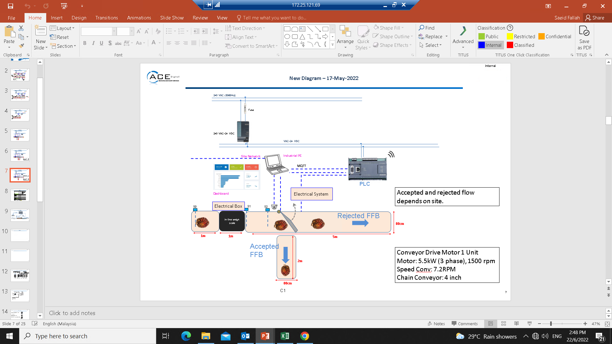

Slide 5


Slide 6
Load Cell Equipment

Slide 7
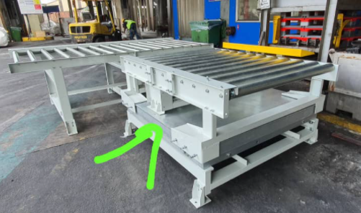
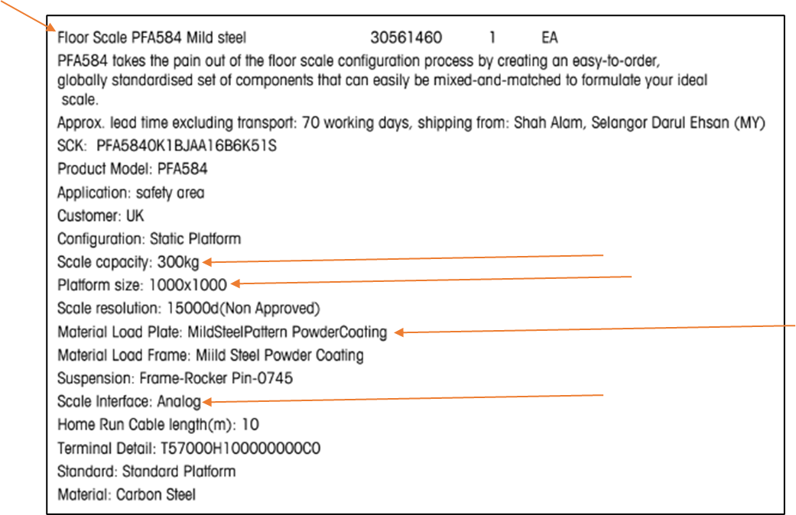
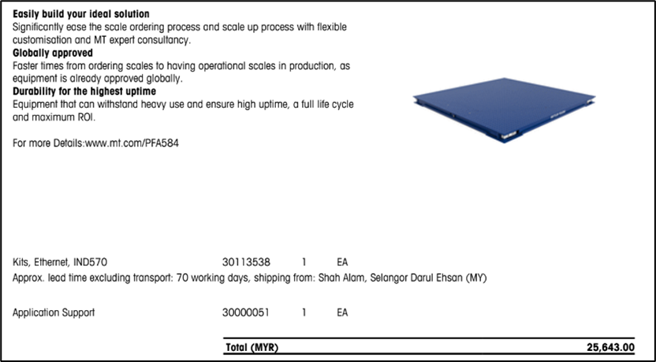
Equipment proposed by Mettler Toledo

Slide 8
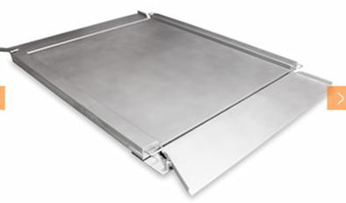
Alternative Floor Scale
Company | Baykon
Capacity | 300 kg
Accuracy
Interface
Lead time
Price | Quotation needed
Support in Indonesia
Link | https://www.baykon.com/en/product-detail/ba-low-profile-floor-scales
Update | Inquiries sent.
BA Low-profile Floor Scales
Notes:
Update:
Baykon replied.
Baykon said mounting a load cell sensor under each of the feet would be more efficient, but floor scale would be more budget-friendly.
Baykon said if the cable is more than 25m, RS485 is more suitable.

Slide 9
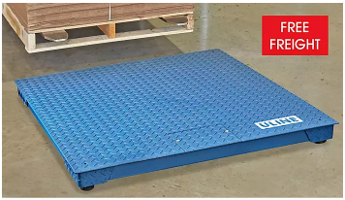
Alternative Floor Scale
Company | ULINE
Capacity | 2500 lbs (1133 kg) / Lowest available
Accuracy | ± 0.2 kg
Interface
Lead time
Price | $1,650
Support in Indonesia
Link | https://www.uline.com/Product/Detail/H-8018/Low-Profile-Floor-Scales/Low-Profile-Floor-Scale-4-x-4-2500-lbs-x-5-lb
Update | Inquiries sent.
Low Profile Floor Scales - H-8018
(1.2m x 1.2m version)
Notes:
Update:
Inquiries sent.
ULINE said not compatible with conveyor because shaky environment may affect the reading.

Slide 10
Alternative Floor Scale
Company | ULINE
Capacity | 5000 lbs (2267 kg)
Accuracy | ± 0.4 kg
Interface
Lead time
Price | $1,265
Support in Indonesia
Link | https://www.uline.com/Product/Detail/H-3001/Low-Profile-Floor-Scales/Low-Profile-Floor-Scale-3-x-3-5000-lbs-x-1-lb
Update | Inquiries sent.
Low Profile Floor Scales - H-3001
(0.9m x 0.9m version)
Notes:
Update:
Inquiries sent.
ULINE said not compatible with conveyor because shaky environment may affect the reading.

Slide 11
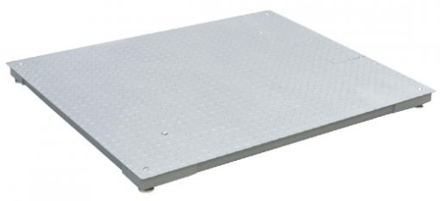
Alternative Floor Scale
Company | Lian Seng Weighing Scale Co.
Capacity | 1,500 kg
Accuracy
Interface | RS232
Lead time
Price | Quotation needed
Support in Indonesia
Link | http://www.lianseng-scales.com.sg/product/t31p-tf-floor-scale-series/
Update | Inquiries sent.
T31P-TF Floor Scale Series
(T31P-TF1212-1.5T)
(1.2m x 1.2m)

Slide 12
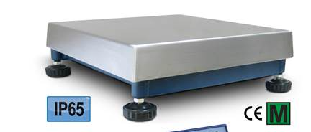
Alternative Floor Scale
Company | Vetek
Capacity | 600 kg
Accuracy
Interface | RS232 / RS485
Lead time
Price | RM 7,077
Support in Indonesia
Link | https://www.vetek.com/floor-scale-600kg50g-800x800x165mm-ip65-stainless-cover-pbe600v-en/article
Example image only
PBE600V
(0.8m x 0.8m)

Slide 13
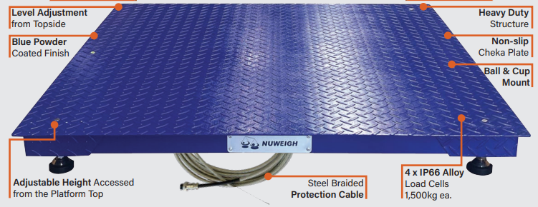
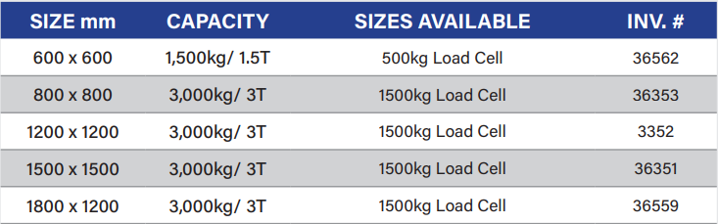
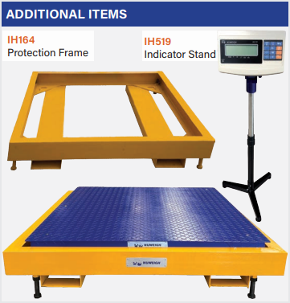
Alternative Floor Scale
Company | Nuweigh
Capacity | 1,500 kg (Lowest available)
Accuracy
Interface | RS232
Lead time
Price | Quotation needed
Support in Indonesia
Link | https://www.nuweigh.com.au/products/nuweigh-ih1949-powder-coated-blue-base/
Update | Inquiries sent.
IH1949
Remark: Has many other models/options in their website.

Slide 14
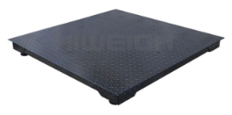
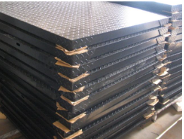
Alternative Floor Scale
Company | Hiweigh
Capacity | 1,500 kg (Lowest available)
Accuracy
Interface | RS232
Lead time
Price | $840
Support in Indonesia
Link | https://www.hiweigh.com/product-details/fd-floor-scale/
Update | Inquiries sent.
FD1015M
(1.0m x 1.0m)

